Slide 1
Why Healthcare Workers are Key to Ending the AIDS Epidemic
Capitol Hill, March 2, 2015
Lisa Carty, Director
UNAIDS Liaison Office, Washington, DC

Slide 2
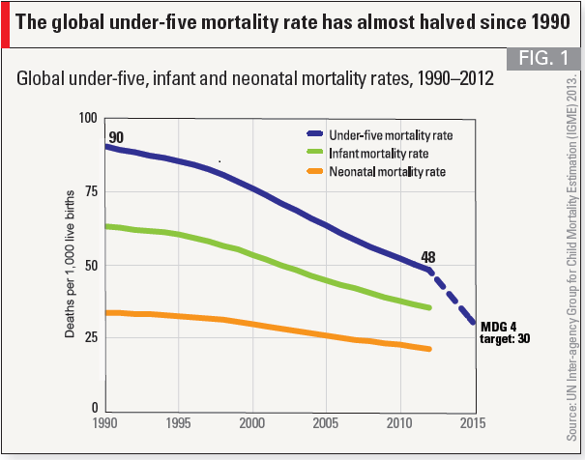
Declines in Child Mortality

Slide 3
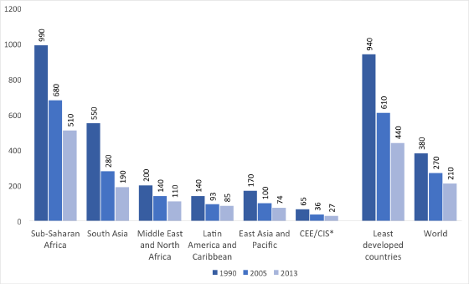
Declines in Maternal Mortality

Slide 4
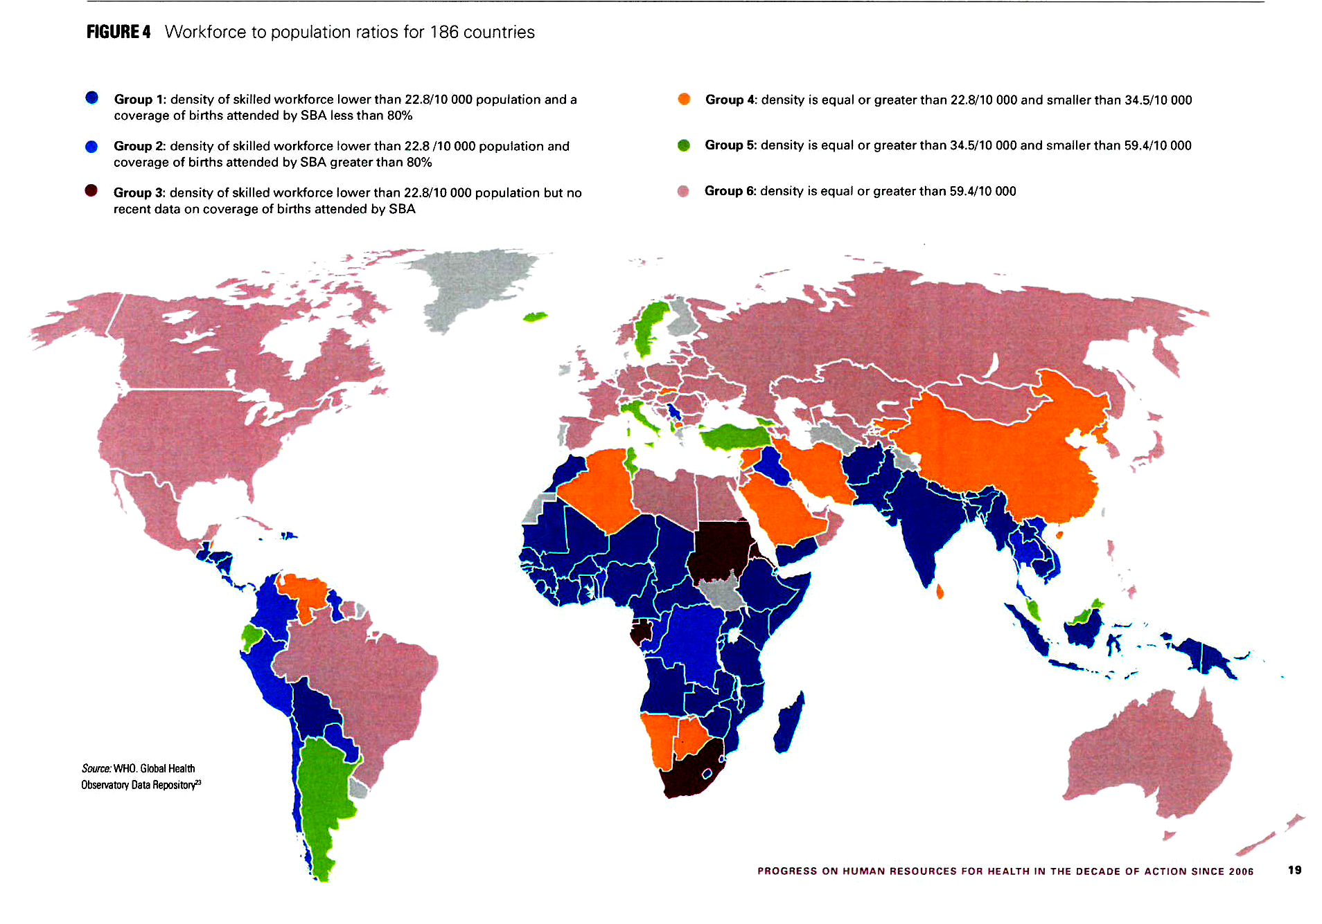
Healthcare Workforce: Population Ratios
Source: WHO Global Health Observatory Data Repository
Notes:
The example of Ethiopia:
Political leadership led to massive surge in number of health care workers resulted in great health outcomes.
About 10 years ago, Ethiopia’s Former Minister of Health Tedros Adhamon Ghebryesus encouraged the Ethiopian government to train, support and pay tens of thousands of frontline health workers in rural and neglected areas. As a result:
Ethiopia met the Millennium Development Goal (MDG) 4 target of slashing child mortality by two-thirds from 1990 to 2015 two years ahead of schedule. The country is expected to soon meet the MDG 5 target of decreasing maternal mortality by three-quarters. Ethiopia is one of thirteen countries that has reached the “tipping point” with annual number of people initiating ART treatment exceeding the number of people newly infected, resulting in both a 50% decrease in AIDS associated mortality and a 90% reduction in HIV incidence (now 0.03%) since the introduction of PEPFAR in Ethiopia in 2005.

Slide 5
“90/90/90”: An Ambitious Target to Help End the AIDS Epidemic
90%
of all people living with HIV will know their HIV status
90%
of all people diagnosed with HIV will receive sustained antiretroviral therapy.
90%
of all people receiving antiretroviral therapy will have durable suppression.
Notes:
There is global agreement that to end AIDS by 2030, UNAIDS’ “90/90/90” treatment target must be met by 2020. The target means:
90% of all people living with HIV will know their status
90% of people diagnosed with HIV will receive sustained antiretroviral therapy
90% of all people receiving antiretroviral therapy will have durable viral suppression
Rapid scale up of testing, access to treatment, lab monitoring and counselling services are required to meet the Fast-Track targets.

Slide 6
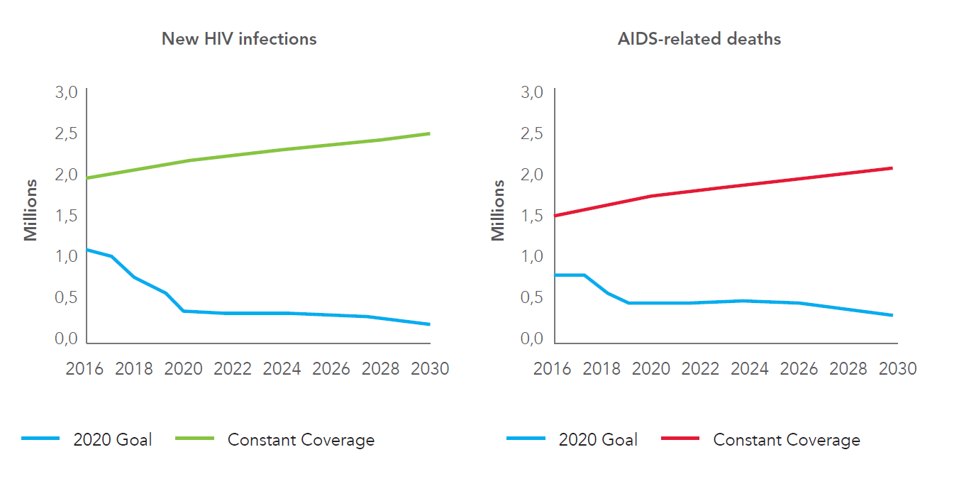
Impact of 90-90-90 target on HIV infections and AIDS-related deaths, 2016-2030
Source: The Gap Report, UNAIDS, 2014.

Slide 7
Antiretroviral treatment coverage varies between regions

Slide 8
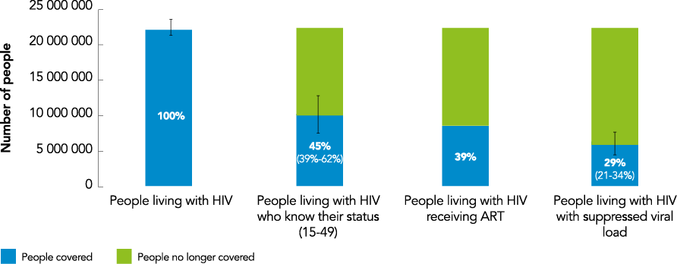

Slide 9
Elements of Success
Flexible approaches that are community-based and community-led
Political leadership and innovation
Integration of services – the “HIV-plus model”
Reduction of stigma and discrimination
Quality standards
Women in the health care workforce

Slide 10
“A health system is only as strong as the men and women who implement it.”
- UNAIDS-AU; Abuja+12 Shaping the Future of Health in Africa

